Slide 1
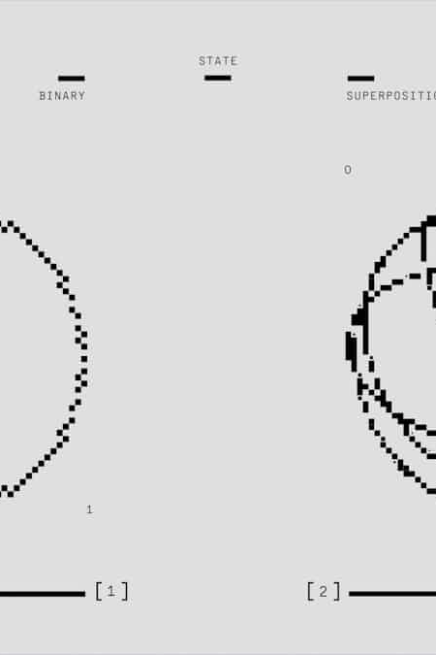
Numerical Methods Algorithm Construction
An assignment by Group 19 showing computational solutions for mathematical problems involving numerical methods using MATLAB.

Slide 2

Project Overview
Part A: Root Finding
Part B: Ordinary Differential Equations
We applied Newton-Raphson, Bisection, Secant, and Fixed-Point Iteration methods for solving equations.
We applied Euler's, Heun's, and Runge-Kutta methods for solving ordinary differential equations
Project Note: Real-World Applications
Carried out Projectile motion analysis and Newton's cooling law implementation

Slide 3
Research Methodology
01
02
Literature Review
Algorithm Development
We reviewed numerical approximation methods and studied flow charts and pseudocodes.
We then constructed algorithms for each method with proper documentation.
03
04
Implementation
Analysis & Visualization
With the help of external sources, we coded solutions in MATLAB with debugging and testing phases.
We finally created plots comparing accuracy and computational time for each methods.

Slide 4
METHODOLOGY
We shall solve the given equations using various numerical methods for finding roots of functions and solving ordinary differential equations.
These include the Newton–Raphson Method, the Secant Method, the Bisection Method, and the Fixed-Point Iteration Method. And for ODEs we have Euler’s, Heun’s and Runge’s methods.
The work was done by constructing flowcharts, pseudocodes, and then algorithms for each of the methods. Using the constructed algorithms, we solved different equations and compared the methods.
We applied the algorithms on two test equations followed by one practical real-world application while also recording the time taken for each solution. This enabled us to plot graphs showing the accuracy of the solutions against the time required for computation.

Slide 5
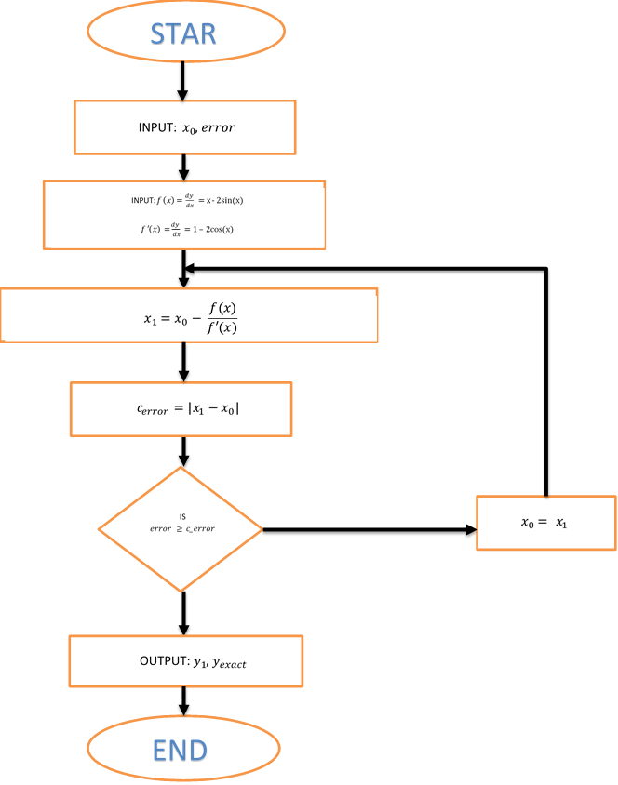
FLOWCHART: NEWTON RAPHSON’S METHOD

Slide 6
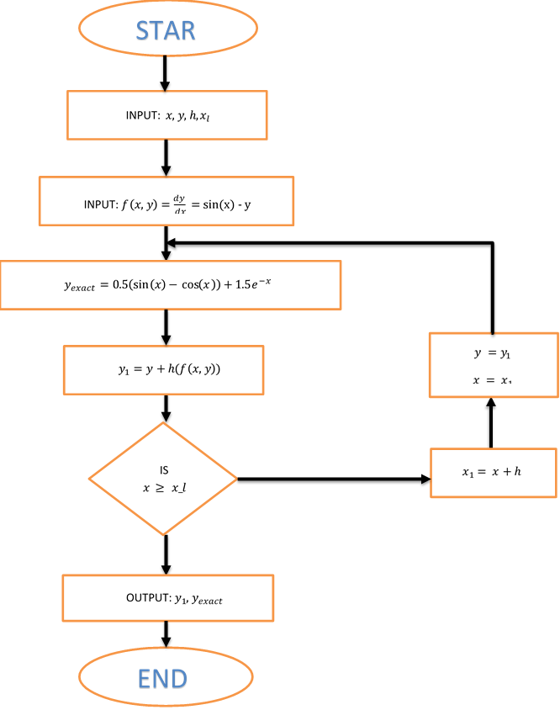
FLOWCHART: EULER’S METHOD

Slide 7
PSEUDOCODE: NEWTON’S RAPHSON FOMRULA
Using Newton Raphson Formula
Initialize:
Check how many d.p are required
Initial approximation says, x = 5
State the error(tolerance)
Compute the function at initial approximation:f(x) = x – 2sin(x)
Compute derivative: f’(x) = 1 - 2cos(x)
Compute predicted next value from x_1 = x_0 + f(x_0)/f’(x_0)
Compute the calculated error c_error = |x_1 – x_0 |
While c_error > error:
Update x_0 = x_1
Compute next value x_1
Update new c_error
Output stored final results in table and computation time.

Slide 8
PSEUDOCODE: EULERS ALGORITHIM
Using Newton Raphson Formula
Initialize:
step size h = 0.2
initial values x = 0,y = 1
upper limit x_l = 1.8
Compute exact solution at initial point: y_exact = 0.5*(sin(x) - cos(x)) + 1.5*exp(-x)
Compute derivative: y_d = sin(x) - y
Compute predicted next value: y_1 = y + h*y_d
Store (x, y, yexact, error) in results.
While x < x_l:
Update x = x + h
Set y = y_1
Compute derivative: y_d = sin(x) - y
Update predicted next value: y_1 = y + h*y_d
Compute exact solution y_exact
Store (x,y,y_exact,error) in results
Output results table and computation time

Slide 9




Root Finding Methods
Newton-Raphson
Secant Method
Uses derivative information for rapid convergence.
Approximates root using two points assumed.
Bisection Method
Fixed Point Iteration
Divides range interval repeatedly to isolate root.
Rearranges equation to x = g(x) form that converges.

Slide 10
EXAMPLE CODE: Newton Raphson’s Formulae method
X = 2; %Initial Approximation
ERR = 0.00005; %Error(depends on d.p required)
F = @(X) X - 2*sin(X); %FUNCTION
F_D = @(X) 1 - 2*cos(X); %functions derivative
X1 = X - (F(X)/F_D(X)); %Finding the next root
R_ERROR = abs(X1 - X);
%%Using a while loop to repeat for n iterations
while R_ERROR > ERR
X = X1;
X1 = X - (F(X)/F_D(X))
R_ERROR = abs(X1 - X);
end
X1 = 1.8955
X1 = 1.8955
disp(["Final answer is:", num2str(X1)])
"Final answer is:" "1.8955”

Slide 11
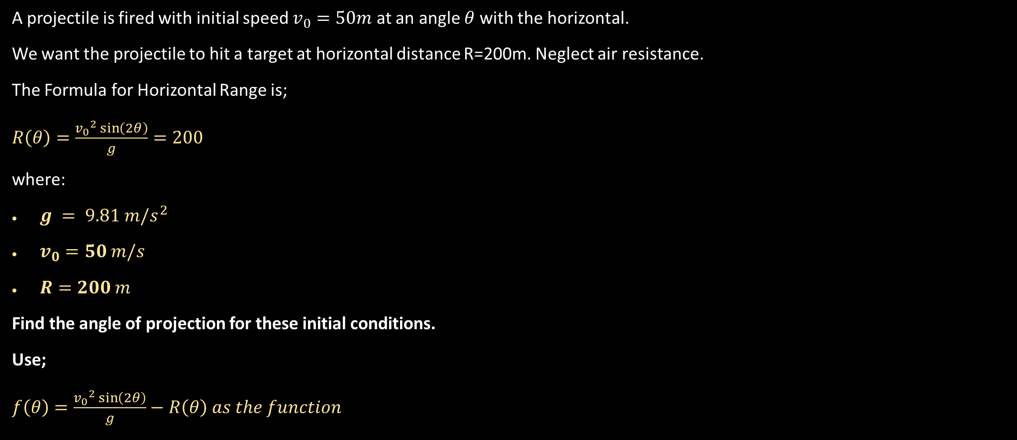
Root Finding Methods: Real World Application
A projectile is fired with initial speed $v_{0}=50m$ at an angle $θ$with the horizontal.
We want the projectile to hit a target at horizontal distance R=200m. Neglect air resistance.
The Formula for Horizontal Range is;
$R\left(θ\right)=\frac{{v_{0}}^{2}\sin\left(2θ\right)}{g}=200$
where:
$g = 9.81 m/s^{2}$
$v_{0}=50 m/s$
$R=200 m$
Find the angle of projection for these initial conditions.
Use;
$f\left(θ\right)=\frac{{v_{0}}^{2}\sin\left(2θ\right)}{g}−R\left(θ\right) as the function$

Slide 12
CODE: Newton-Raphson Method (Projectile Motion)
tic
theta = 0.5;
ERR = 5e-6;
%Substituting given data from the question
v0 = 50; g = 9.81; R = 200;
F = @(theta) (v0^2 * sin(2*theta))/g - R;
F_D = @(theta) (2*v0^2 * cos(2*theta))/g;
theta1 = theta - F(theta)/F_D(theta);
R_ERROR = abs(theta1 - theta);
while R_ERROR > ERR
theta = theta1;
theta1 = theta - F(theta)/F_D(theta)
R_ERROR = abs(theta1 - theta);
end
theta1 = 0.4512
theta1 = 0.4512
theta1 = 0.4512
disp(["Newton-Raphson: Launch angle = ", num2str(rad2deg(theta1))])
"Newton-Raphson: Launch angle = " "25.8511"

Slide 13
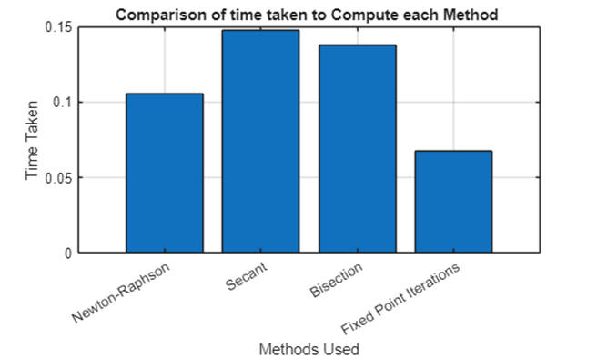
Projectile Motion Application
25.85°
0.067s
Launch Angle
Fastest Method
All methods converged to the same solution with minimal error.
Fixed Point Iteration achieved best performance

Slide 14
Performance Comparison: Root Finding
Fixed Point Iteration emerged as the fastest method at 0.0674 seconds, followed by Newton-Raphson at 0.1056 seconds. Bisection and Secant methods required more computational time but all converged to the same output.
Method | Final_Answers | Computational_Time
'Newton-Raphson' | 25.8511 | 0.1056
'Secant' | 25.8511 | 0.1479
'Bisection' | 25.8511 | 0.1379
'Fixed Point Iterations' | 25.8511 | 0.0674

Slide 15



Ordinary Differential Equations Methods
Euler's Method
Heun's Method
Runge-Kutta
Simple first-order approximation with moderate accuracy
Predictor-corrector approach with improved accuracy
Fourth-order method providing highest accuracy

Slide 16
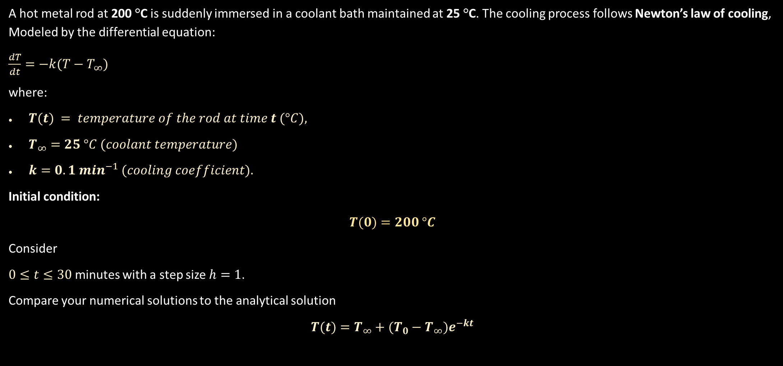
Ordinary Differential Equations Methods
A hot metal rod at 200 °C is suddenly immersed in a coolant bath maintained at 25 °C. The cooling process follows Newton’s law of cooling, Modeled by the differential equation:
$\frac{dT}{dt}=−k(T−T_{∞})$
where:
$T(t) = temperature of the rod at time t (°C),$
$T_{∞}=25 °C (coolant temperature)$
$k=0.1 \min^{−1} (cooling coefficient).$
Initial condition:
$$T(0)=200 °C$$
Consider
$0≤t≤30$ minutes with a step size $h=1$.
Compare your numerical solutions to the analytical solution
$$T(t)=T_{∞}+(T_{0}−T_{∞})e^{−kt}$$

Slide 17
EXAMPLE CODE: Eulers method(Newton’s law of cooling)
tic
% DATA INPUT
x = 0;
h = 1;
y = 200;
x_l = 30;
y_exact = 25 + (200-25)*exp(-0.1*x);
y_d = -0.1*(y - 25);
y_1 = y + h*y_d;
X = [];
Y = [];
Y_exact = [];
Error = [];
X(end+1,1) = x;
Y(end+1,1) = y;
Y_exact(end+1,1) = y_exact;
Error(end+1,1) = abs(y_exact - y);
% USING A WHILE LOOP
while x < x_l
x = x + h;
y = y_1;
y_d = -0.1*(y - 25);
y_1 = y + h*y_d;
y_exact = 25 + (200-25)*exp(-0.1*x);
X(end+1,1) = x;
Y(end+1,1) = y;
Y_exact(end+1,1) = y_exact;
Error(end+1,1) = abs(y_exact - y);
end
Results_Eulers_Cooling = table(X, Y, Y_exact, Error)

Slide 18
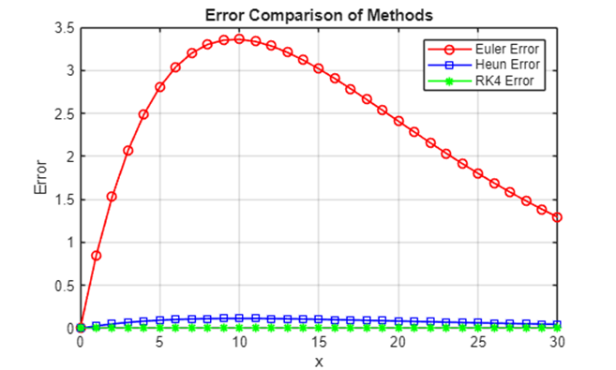
Newton's Cooling Law Application
Method | CompTime
'Euler' | 0.1859
'Heun' | 0.1217
'RK4' | 0.1493
Minimum Error
Time taken
4th Order Runge Kutta Method
Heun’s Method took the shortest time

Slide 19
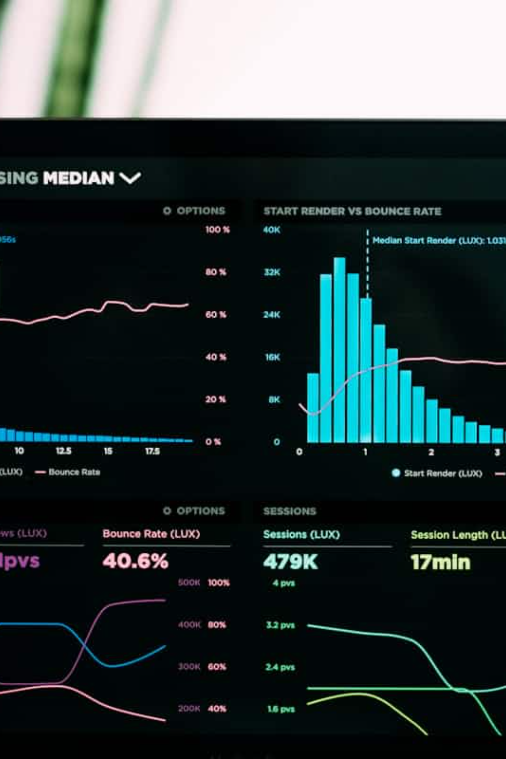
Key Findings
Root Finding
Differential Equations
Fixed Point Iteration fastest but requires equation rearrangement which may be difficult. Newton-Raphson offers best balance of speed and reliability.
Runge-Kutta 4th order provides highest accuracy. Heun's method offers good speed-accuracy compromise.

Slide 20

Conclusion
This project successfully demonstrated MATLAB's capabilities in numerical analysis and algorithm implementation. The comparative study revealed optimal methods for different scenarios:
Method Selection Matters
Choice depends on accuracy requirements versus computational speed.
Visualization Power
Graphs enabled clear comparison and informed decision-making.
Future Applications
We obtained skills applicable to engineering functions and decision-making activities.

